Slide 1
10th Odysseus Argostoli, Kephallonia 24-28 May 2027 www.odysseus2027.com
Venue location and excursions

Slide 2
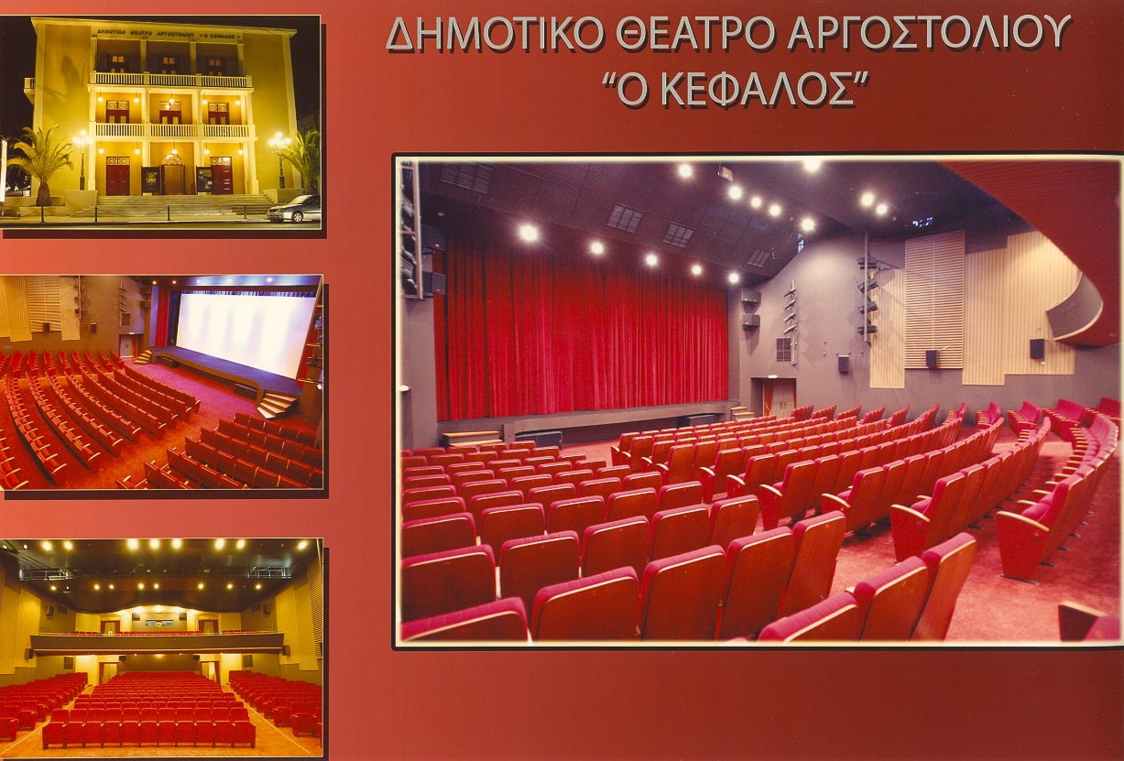
Venue
3 rooms
Ground floor
Main theatre
Open space in the upper floor
Lobby area for coffee breaks
Lunch will be offered in nearby restaurants

Slide 3
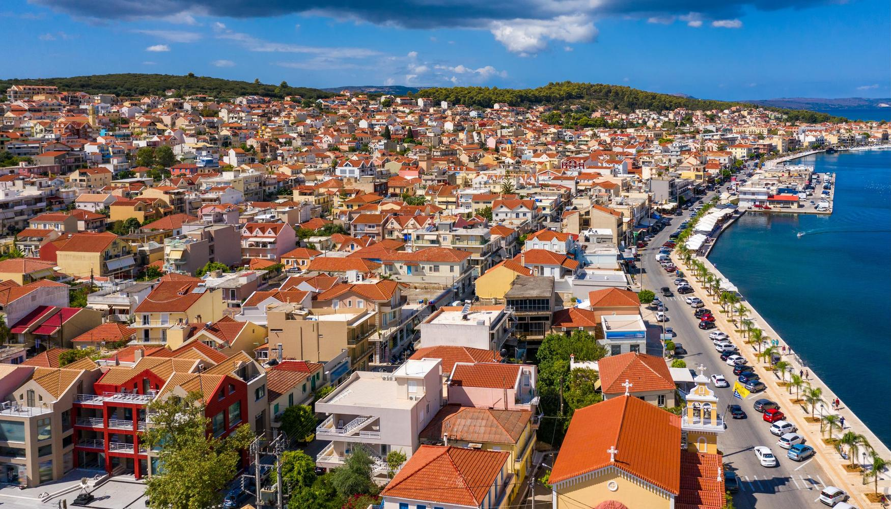
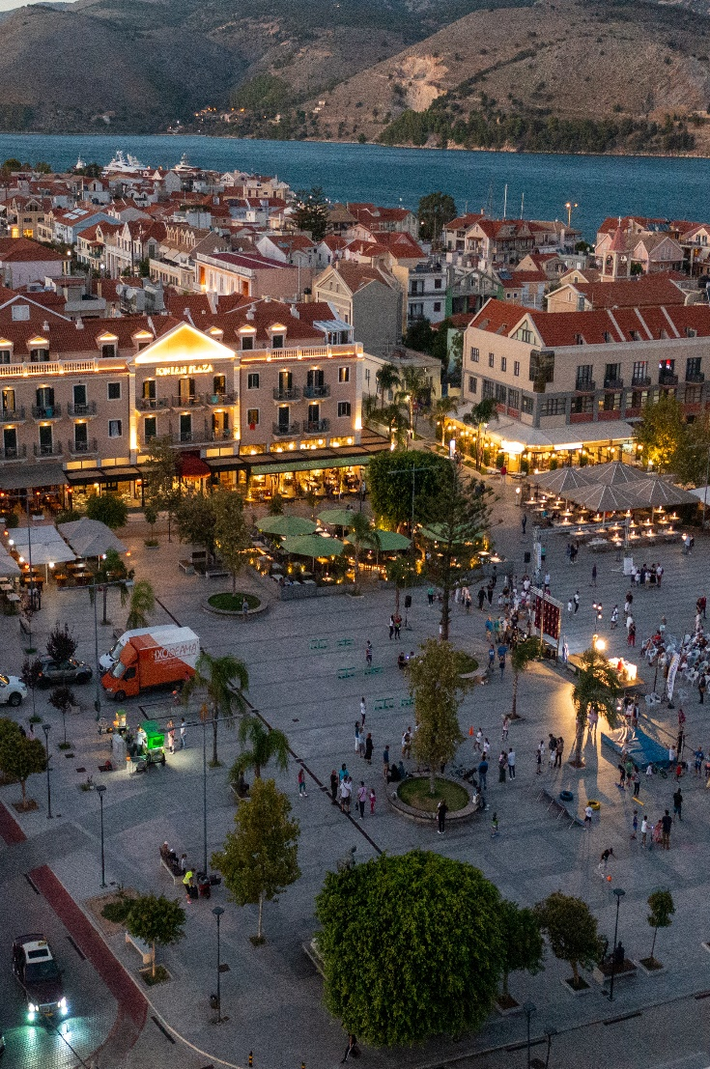
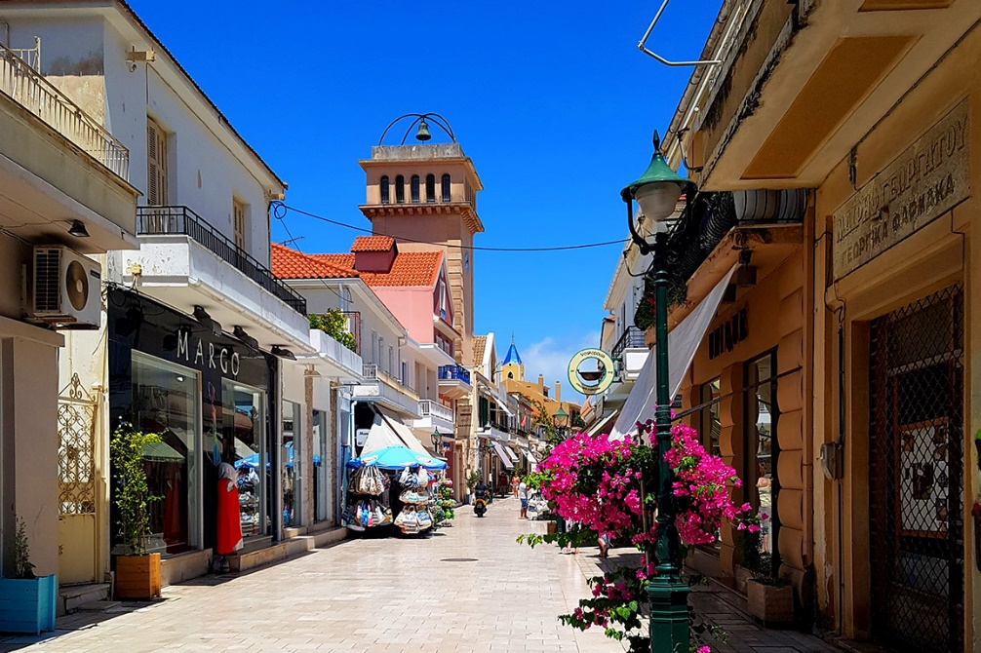
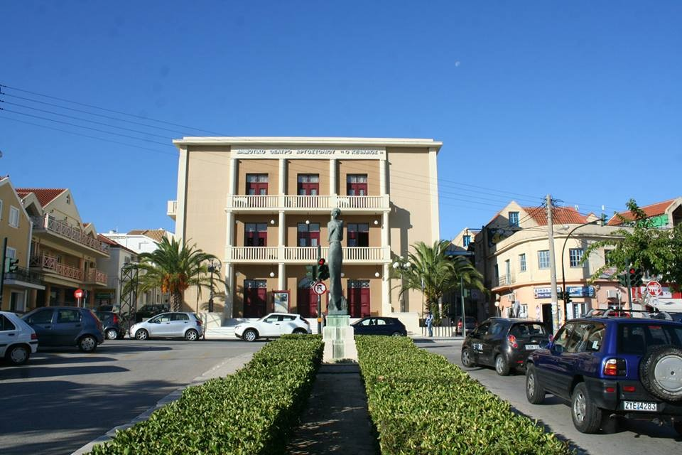
Argostoli

Slide 4
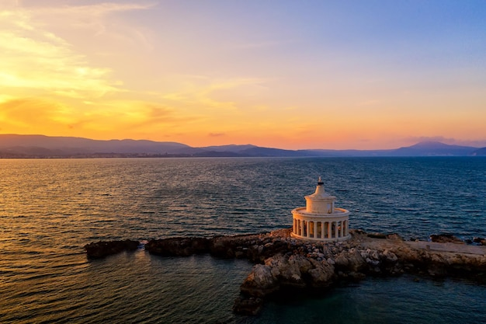
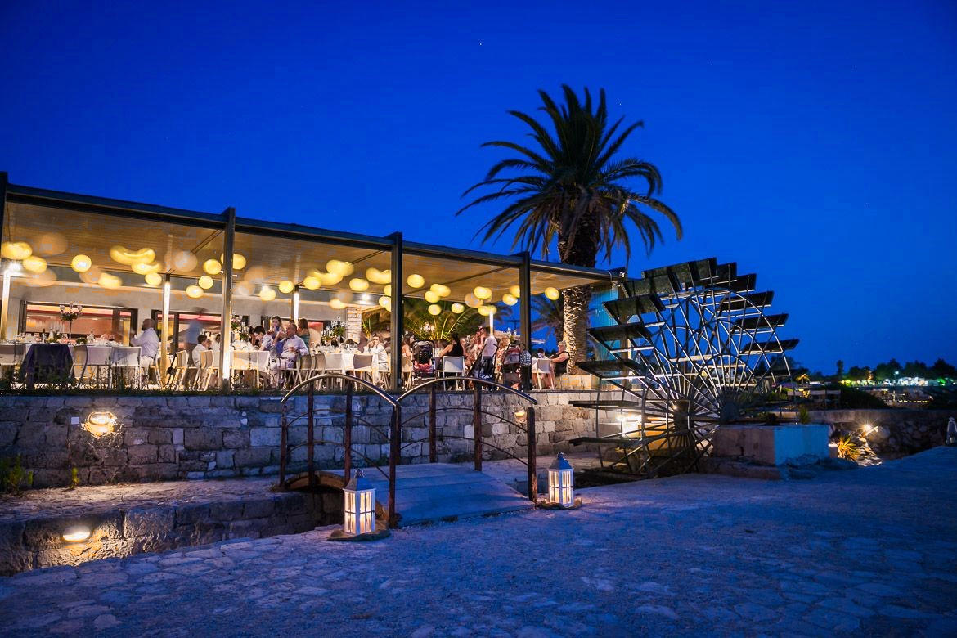
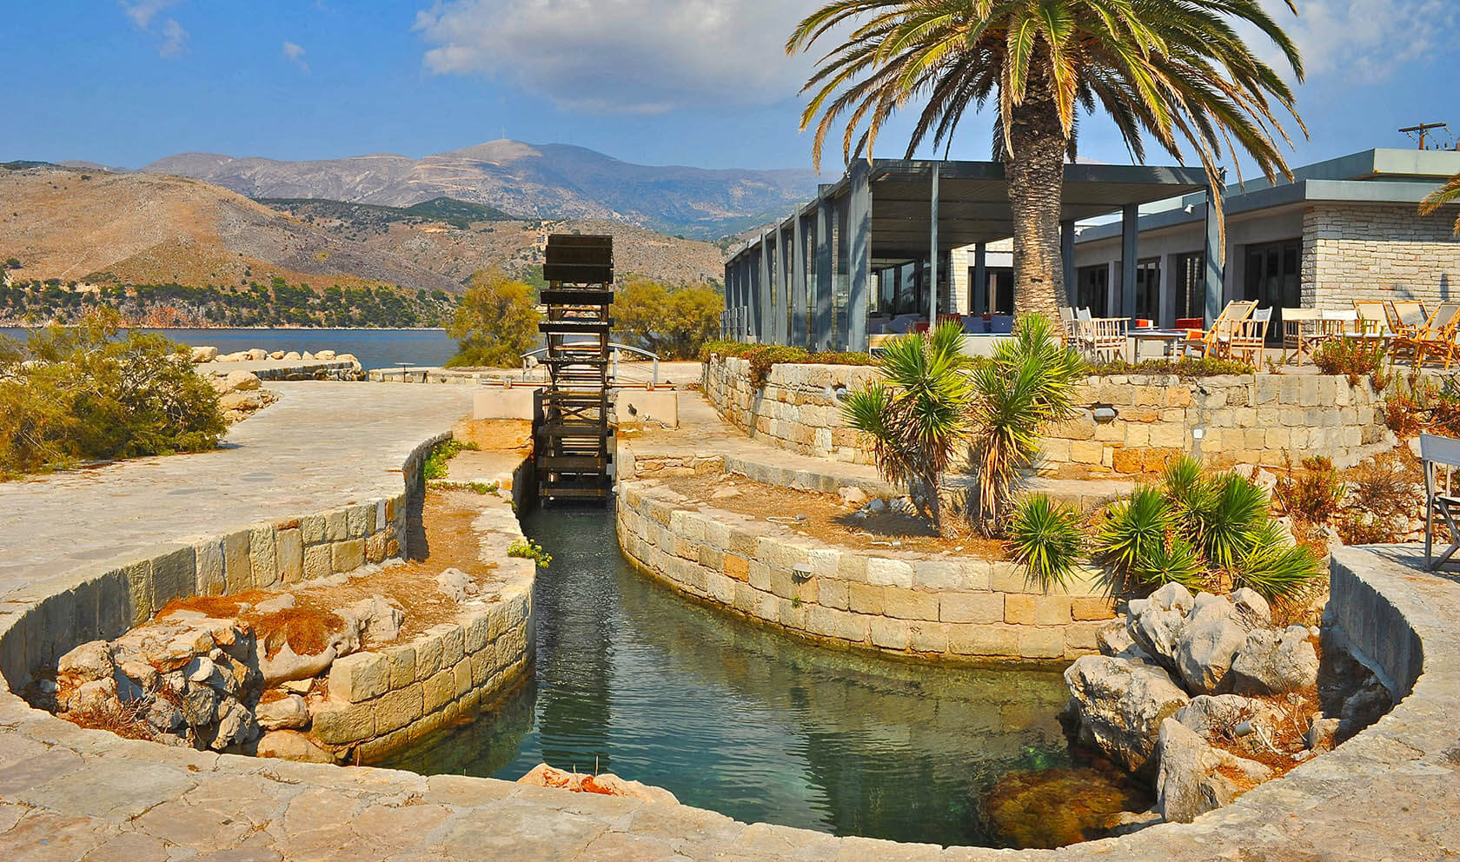
Main Dinner
Katavothres Club Restaurant

Slide 5
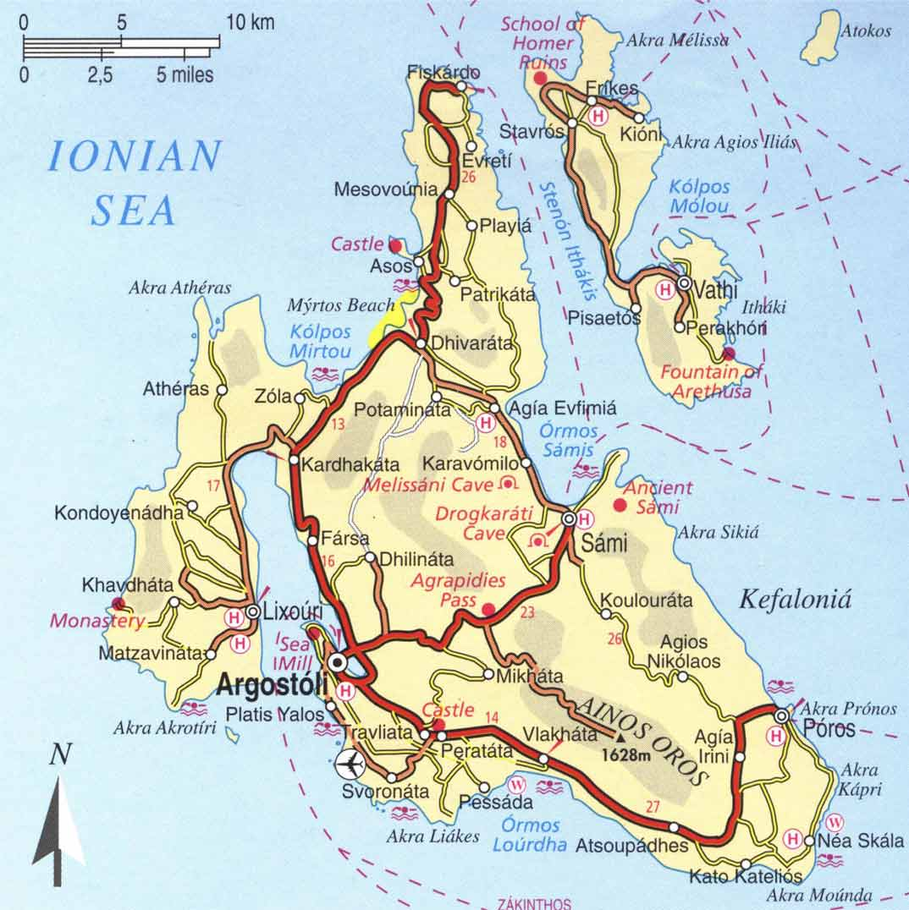
Excursions
From Argostoli travel to Sami
Ancient Sami
Drogkarati Cave
Melissani Cave
From Sami we go North to Fiskardo (or Assos and Castle) for lunch
In the afternoon 20 minute boat to Lixouri (dinner)

Slide 6
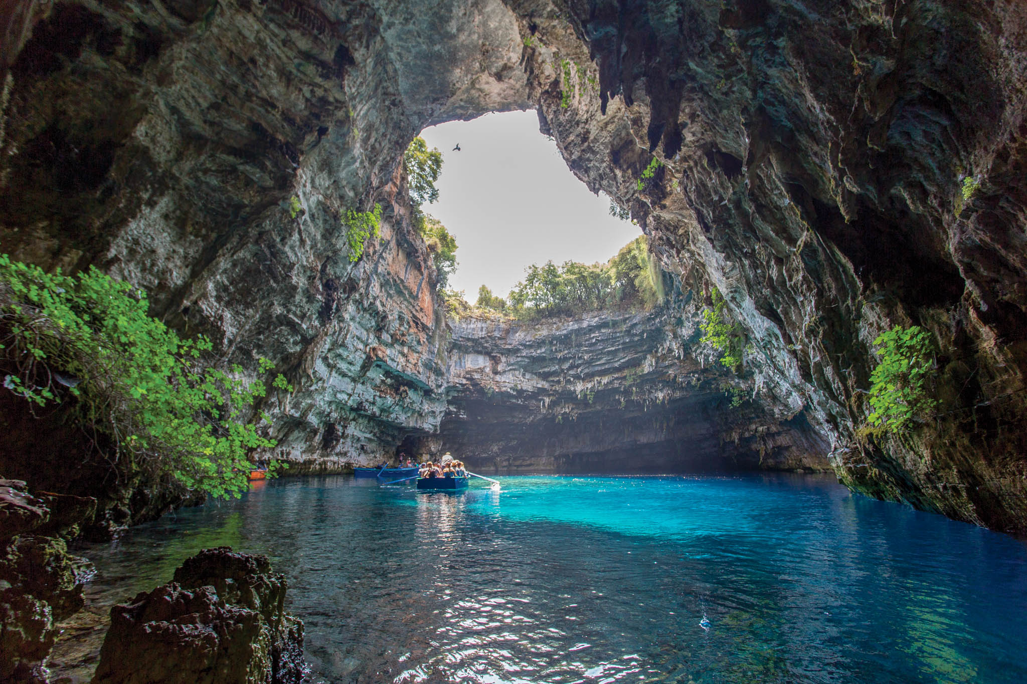
Melisani cave

Slide 7
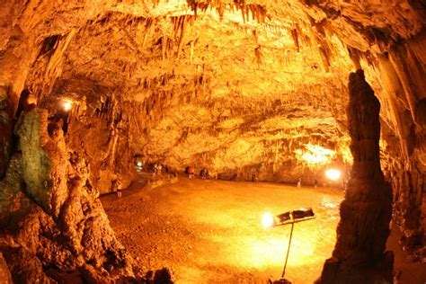
Drogarati Cave

Slide 8
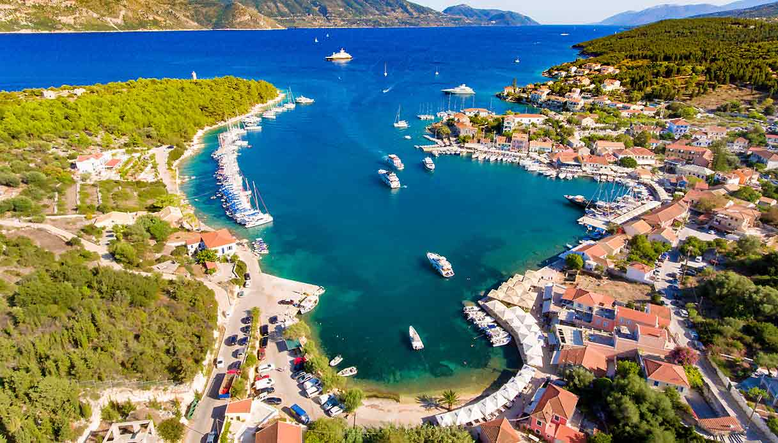
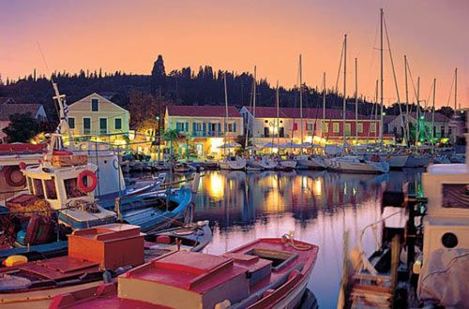
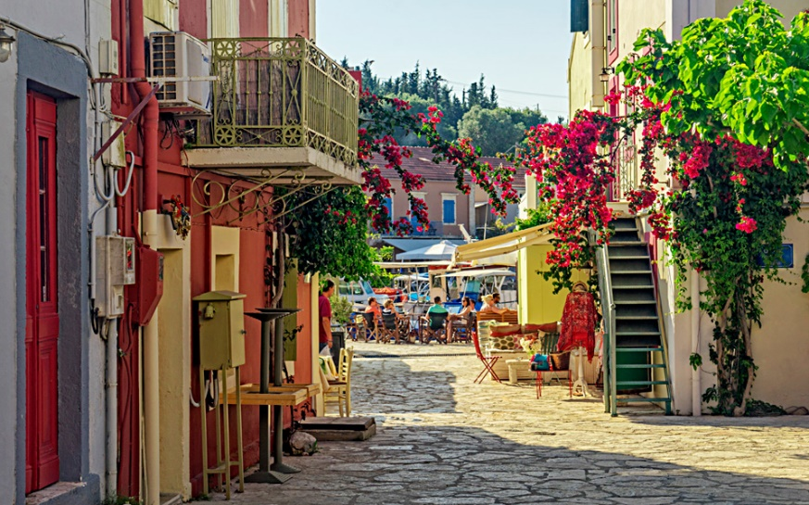
Fiskardo Venetian Village

Slide 9
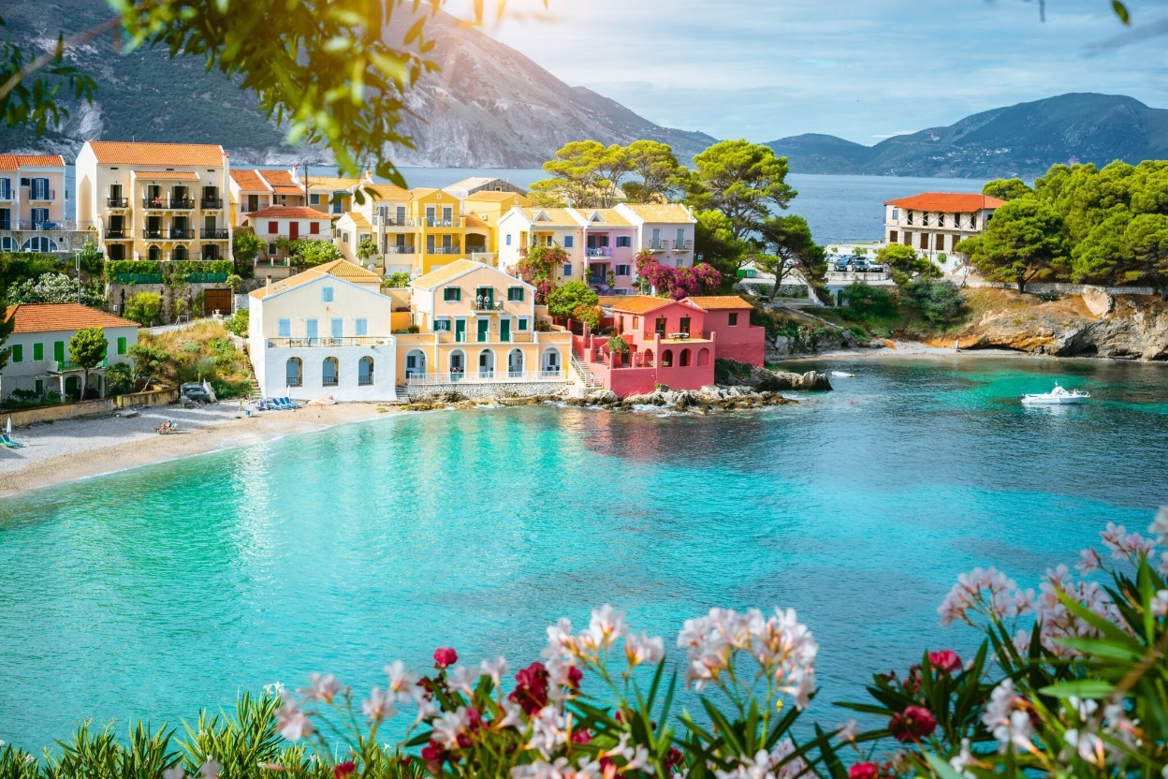
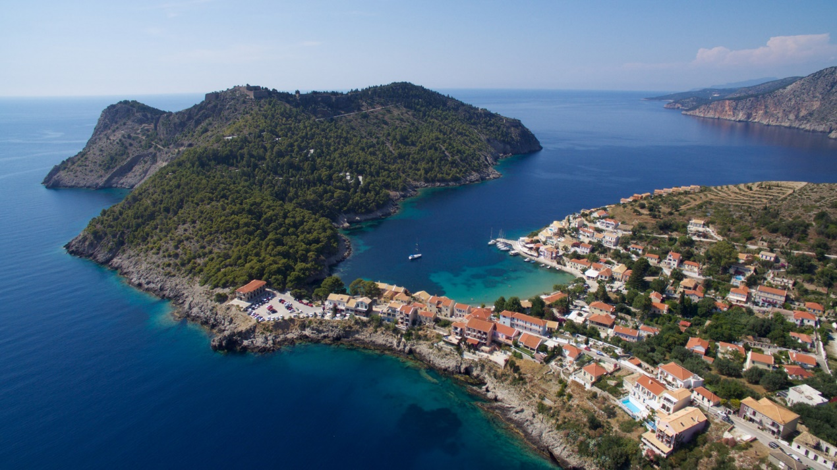
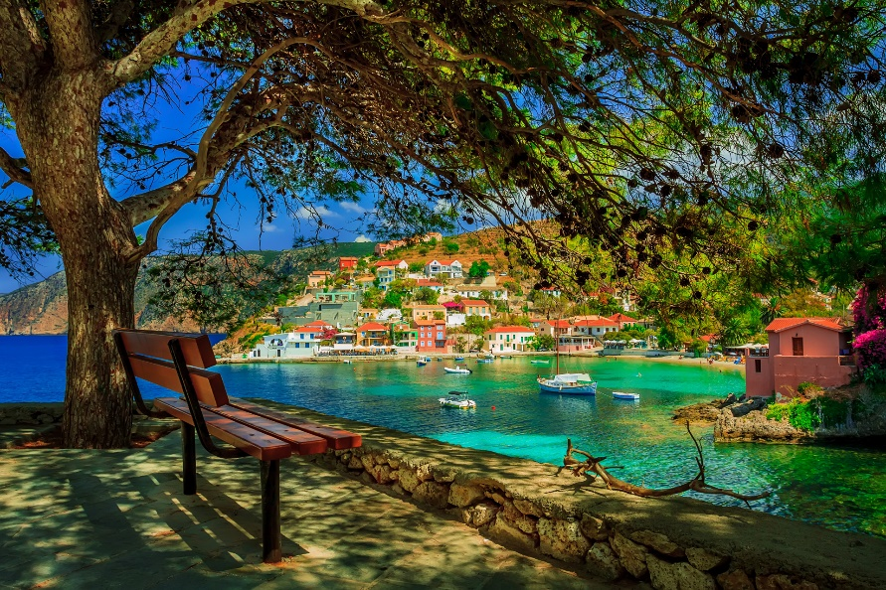
Assos

Slide 10
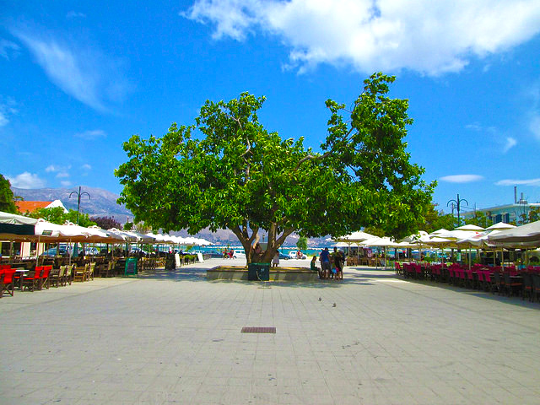
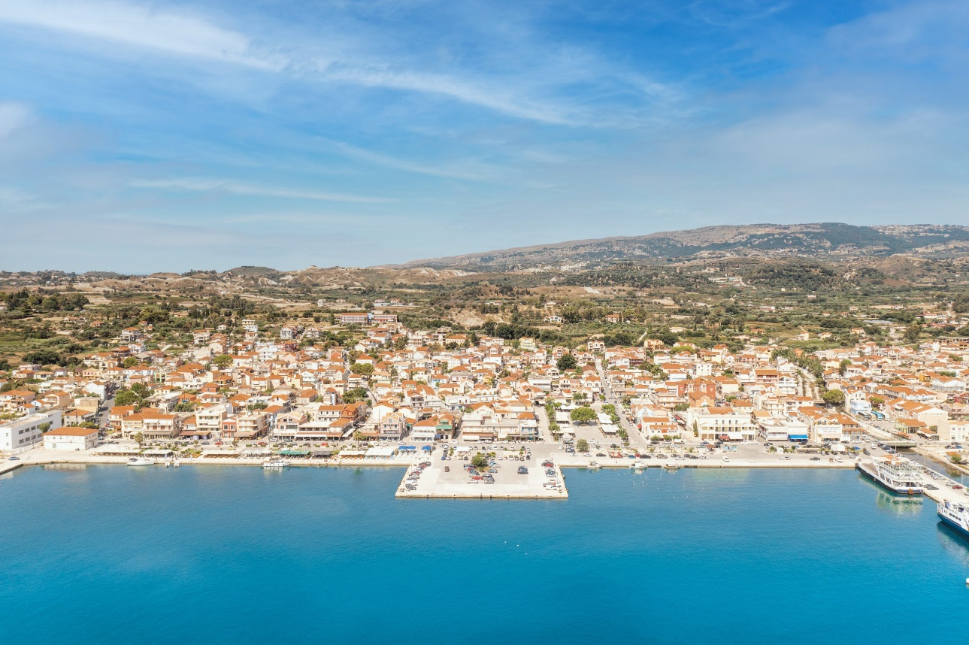
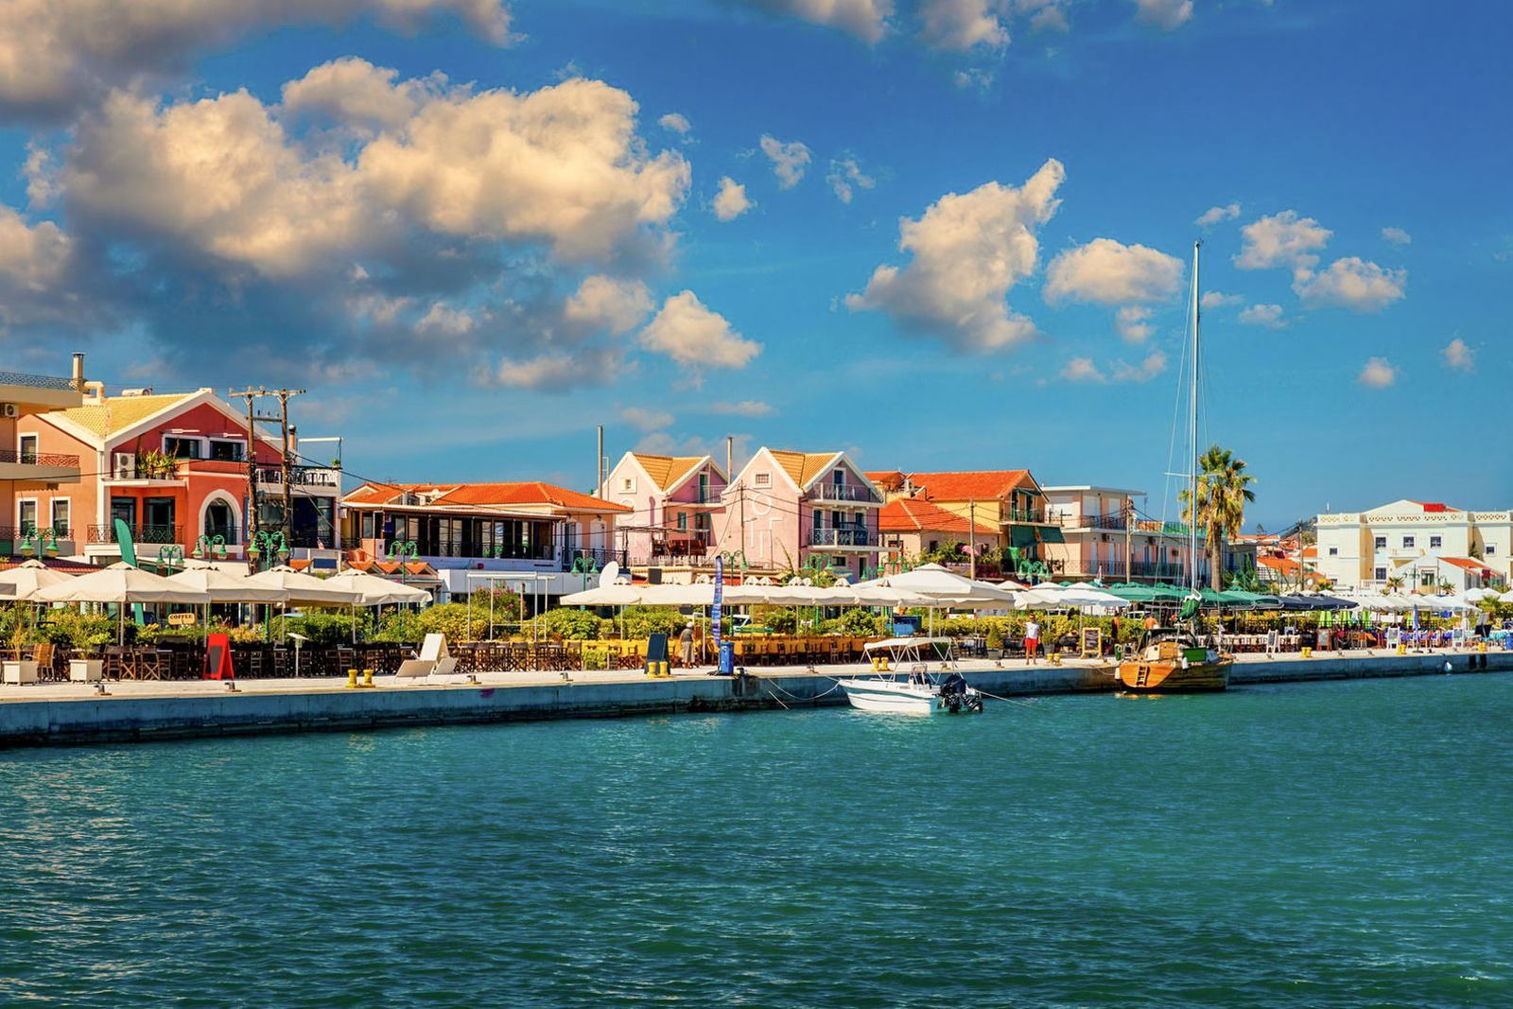
Lixouri

